Slide 1
EduRAG A Smart Learning Assistant for Academic and Research Papers
Presented by:
Venu Gopal Reddy. S

Slide 2
Problem Statement
Academic papers are often complex and time-consuming to read
Challenging for students and researchers to extract insights
Creates barriers to knowledge acquisition and slows progress
Our Solution: EduRAG
RAG system for academic paper comprehension
Simplifies content through AI-powered understanding
Provides summaries and specific answers
Makes research papers more accessible

Slide 3
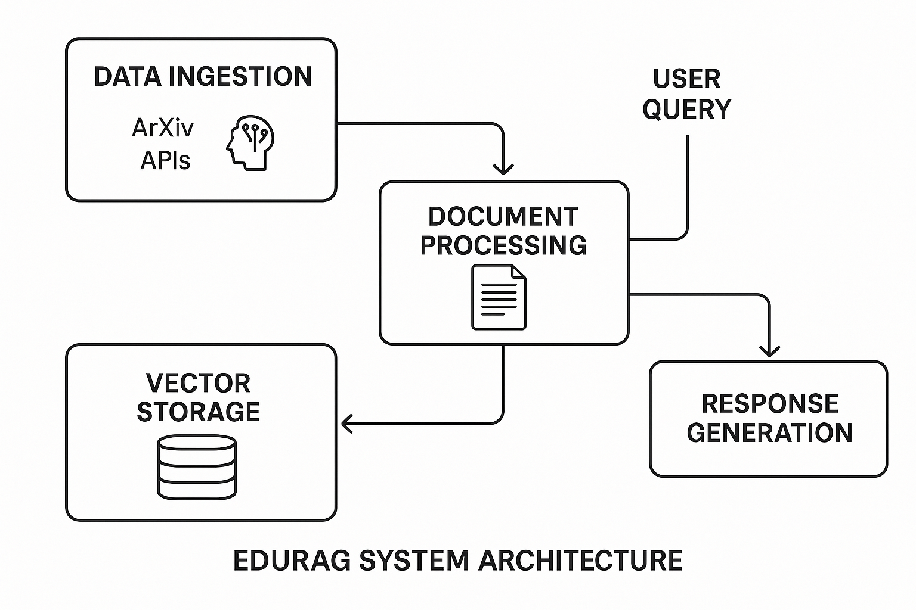
System Architecture
Data Ingestion: Fetch papers from ArXiv & Semantic Scholar APIs
Document Processing: PDF to structured text, split into chunks
Vector Storage: Embeddings for similarity search
Retrieval: Find relevant chunks based on query
Response Generation: LLMs generate coherent answers

Slide 4
Methodology
Model Implementation:
• Phi-2 (2.7B): Compact Microsoft model
• Mistral-7B: Strong open-source model
• LLaMA 3 (8B): Meta's latest with advanced capabilities
Pipeline Process:
• User submits query → Relevant chunks retrieved
• LLM processes query with context → Response generated
Evaluation Framework:
• Domain-specific questions and metrics used
• Multi-dimensional analysis conducted

Slide 5

Domain-Specific Questions
Evaluation Question Set (Examples):
• What are the components of a RAG system?
• Role of embeddings? How does vector storage work?
• Pros/cons of Phi-2 vs larger models?
• Chunking strategy effects? Future research directions?
Question Categories:
• Conceptual (40%), Technical (30%), Comparative (20%), Analytical (10%)

Slide 6
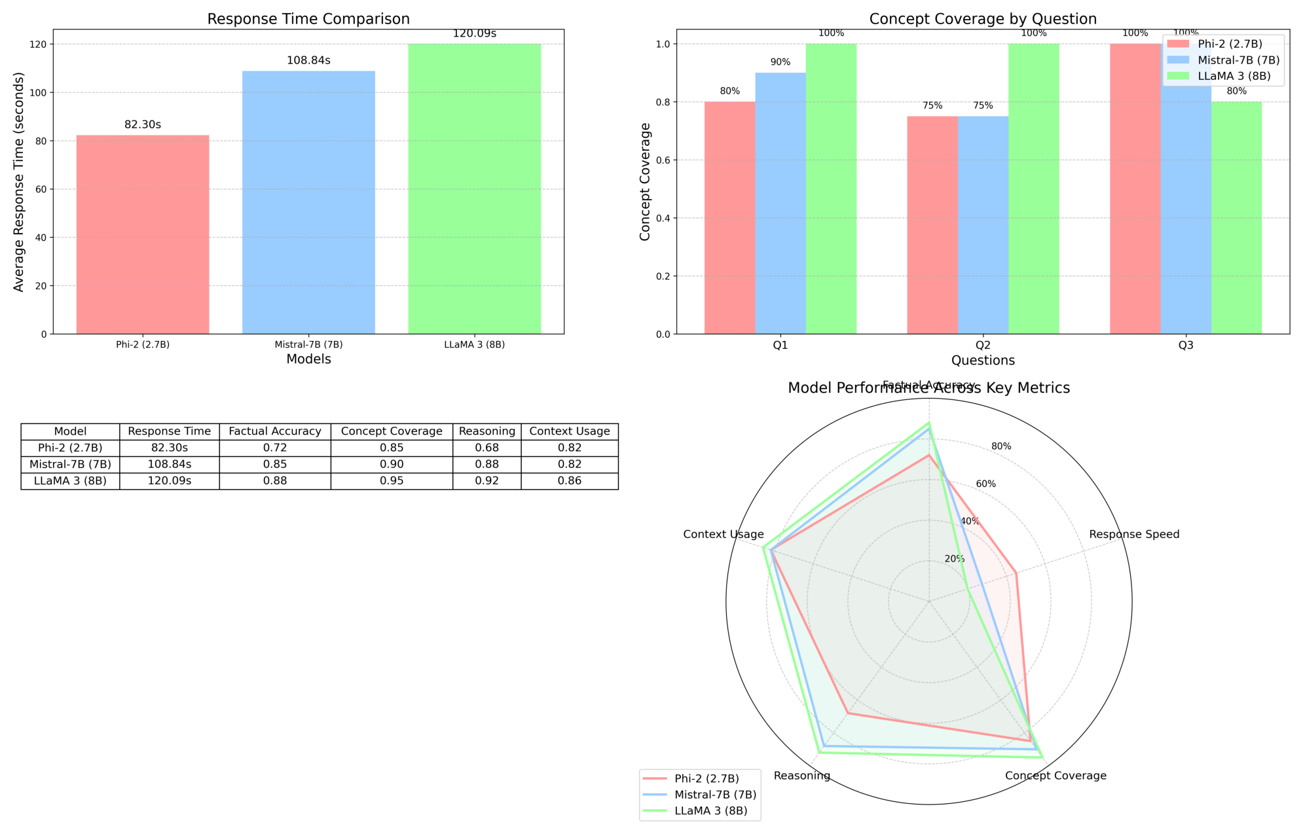
Evaluation Results

Slide 7
Key Findings
Model | Response Time | Factual Accuracy | Concept Coverage | Reasoning | Context Usage
Phi-2 (2.7B) | 82.30s | 0.72 | 0.85 | 0.68 | 0.82
Mistral-7B (7B) | 108.84s | 0.85 | 0.90 | 0.88 | 0.82
LLaMA 3 (8B) | 120.09s | 0.88 | 0.95 | 0.92 | 0.86

Slide 8


Model Strengths and Weaknesses
Phi-2 (2.7B):
Strengths: Fastest, low resource
Weaknesses: Lower accuracy/reasoning
Best for quick lookups, constrained environments
Mistral-7B (7B):
Strengths: Balanced, strong reasoning
Weaknesses: Moderate speed
Best for general education/research
LLaMA 3 (8B):
Strengths: Highest accuracy/concept coverage
Weaknesses: Slowest, high resource
Best for in-depth research

Slide 9
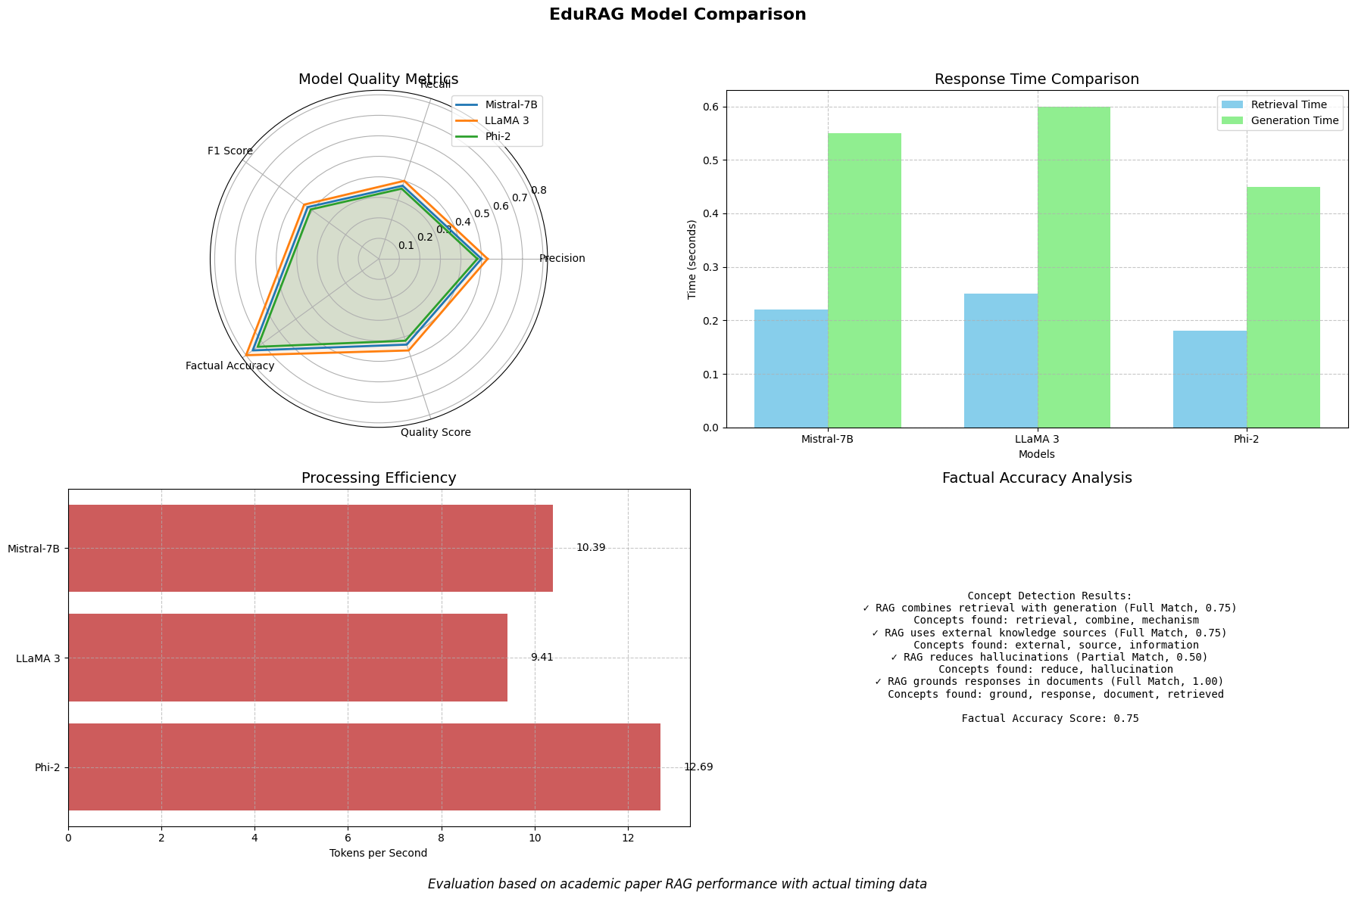
MODEL COMPARISON

Slide 10
User Interface and Experience
Streamlit Application Features:
Web interface for interaction
Paper search & upload
QA with retrieved context
Model selection & visualization
User-Centered Design:
Easy for students/researchers
Clear sources & explanations
Accessible technical content

Slide 11

Future Work
Planned Enhancements:
Multilingual paper support
Multimodal: figures, diagrams
Fine-tuning for specific domains
Speed improvements via optimization
Collaboration features for teams

Slide 12
Conclusion
Project Impact:
Demonstrates RAG for academic comprehension
Insight on trade-offs in model selection
Foundation for accessible research
Key Takeaways:
Larger models = better quality, slower speed
Mistral-7B = best balance for education
RAG grounds answers in source documents
GitHub: github.com/venureddy1718/EduRAG

Slide 13
References
Lewis et al. (2020) - RAG for Knowledge-Intensive NLP Tasks
Karpukhin et al. (2020) - Dense Passage Retrieval
Johnson et al. (2017) - Billion-Scale Similarity Search
Borgeaud et al. (2022) - Retrieving from Trillions of Tokens
Asai et al. (2023) - Self-RAG
Reimers & Gurevych (2019) - Sentence-BERT
Ram et al. (2023) - In-Context RAG

